Slide 1
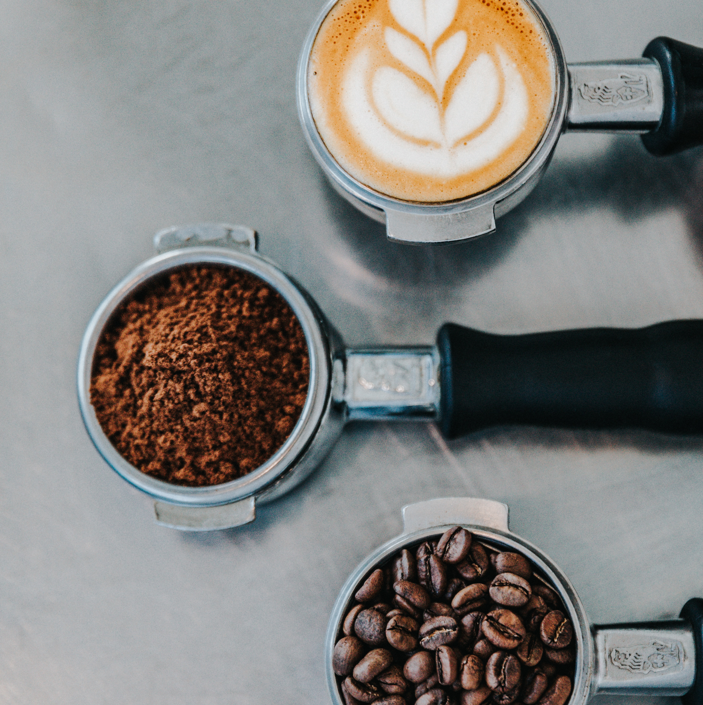
Global Coffee Trade
Cindy Wong & Sandra Botica
Notes:
Photo by
https://unsplash.com/@nate_Dumlao
Nathan Dumlao on
https://unsplash.com/photos/zUNs99PGDg0
nathan-dumlao-Y3AqmbmtLQI-unsplash.jpg
Photo by Nathan Dumlao on Unsplash

Slide 2
Data Story
The number of countries producing (exporting) coffee and what volume?
The number of countries buying (importing) coffee and what volume?
Price paid to growers.
Retail price.
Notes:
4 parts to this data story. 1990-2019, but more about the data later.
Exports (55 countries)
Imports (35 countries)
Countries, continents, volume in Thousand 60kg bags, Information derived from monthly reports.
Price paid to growers (62 countries)
US cents/lb as an annual average. (Keep in mind that 60kg is 132.277 pounds i.e. 1 kg = 2.20462 pounds)
Avg price paid to to grower at farmgate
OR min price guaranteed by the gov to the grower by form and weight reported in the national currency in which the coffee is purchased, converted to US cents/lb.
Coffee-type
Colombian Mild(27/62 countries)
Other milds(27/62 countries)
Brazilian Naturals(27/62 countries)
Robustas(27/62 countries)
Retail price (28 countries)
(Global price of coffee)
US $/lb as an annual average.
Price paid by consumer to commercial distributor outlet.

Slide 3
Data Story
Market analysts and researchers can consult this data as an indicator of prices paid to farmers in coffee producing countries.
Understand the top 5 importing and exporting countries.
Commodity experts can create statistical reports using this data.
Notes:
Coffee as a discretionary item. Inflation and low economic growth, consumers buying less.
Supply factors affecting price(as a commodity)
Climate
inventories
supply chain disruptions
variations in the number of producing countries
investment levels and productivity of key coffee-producing nations.
Demand for coffee
Global economic conditions and the impact.

Slide 4

Data Source
International Coffee Organization
Historical Data on the Global Coffee Trade
https://www.ico.org/new_historical.asp
Notes:
Started with a Kaggle website https://www.kaggle.com/datasets/michals22/coffee-dataset?select=Coffee_domestic_consumption.csv
Then found the International Coffee Organization
Selected 4 excel spreadsheets of historical data.
Original data source to cleaned csv. Numerous blank rows, subtitles for regions in rows, coffee type columns. Tried this in python and then excel.
A lot of null values, but still relevant or insightful to the story. Csv’s in cleaned resources folder.
LIMITATIONS regarding data e.g reference to pounds as a weight, especially if this story is presented to an Aus audience.
Photo
https://www.dreamstime.com/photos-images/coffee.html

Slide 5
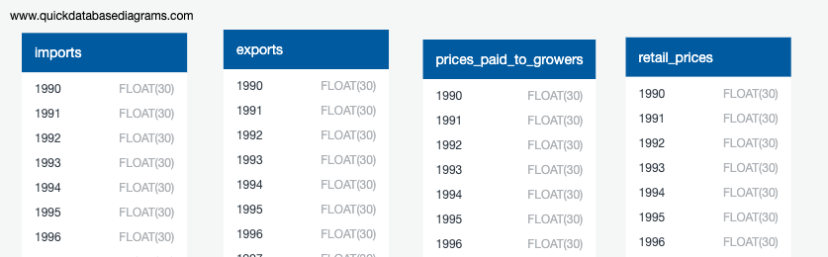
Database
QUICK DBD
Export PostgreSQL
pgAdmin4
Created 4 tables, import data from Resources files
Notes:
Pivoted tables (thousand of rows e.g. country 1990, country 1991 to 2019, then next country, next csv…..crazy idea)
Unpivoted tables so that one row was a dictionary for a country, with key:value pairs being Year:value (volume or price) API data links.
Also, experimented with joins of 4 tables to create 1 file for the API.
Created a database.
Experimented with Mongodb.
Switched to SQL.
Had difficulty in setting up Flask API in app.py
Had to use username and password to coffee database in postgressql. Very new concept.
I wasn’t able to select/connect data using Base = automap_base() Base.prepare(autoload_with=engine) so no references to tables Coffee = Base.classes.coffee
Hence had written app.py syntax using this methodology with no return in python experiment.
Changed to reading sql.

Slide 6
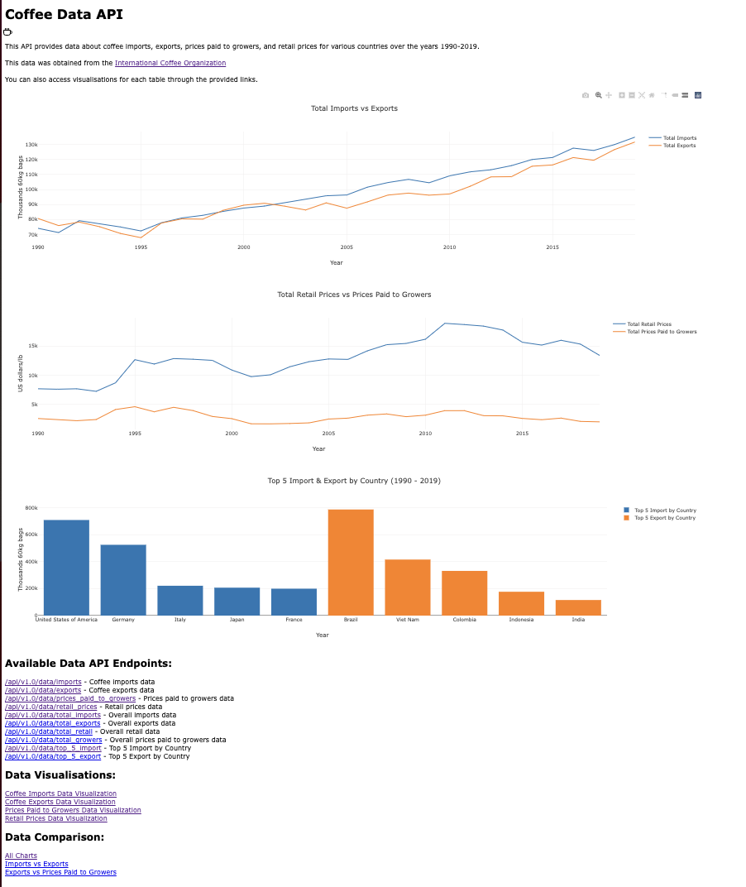
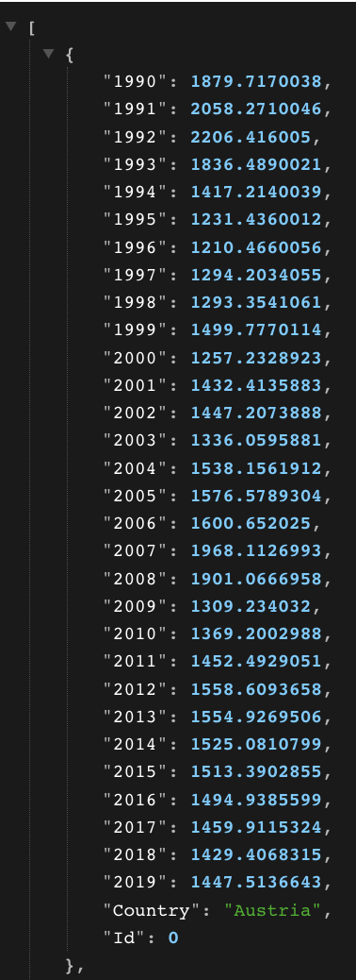
Python Flask API & Plotly
app.py
index.html
javaScript, css, html
Notes:
http://127.0.0.1:5000

Slide 7

Export visualisation
Notes:
Photo by Christina Rumpf on Unsplash
Top 5 exporters (our data)
Brazil, Vietnam, Colombia, Indonesia, India
According to Worldbank.org in 2019
https://wits.worldbank.org/trade/comtrade/en/country/ALL/year/2019/tradeflow/Exports/partner/WLD/product/090111#:~:text=In%202019%2C%20Top%20exporters%20of,872%2C355.44K%20%2C%20355%2C766%2C000%20Kg).
Brazil 4,575,001.61 (1000USD) (6,569,702.31196 AUD)
Colombia 2,272,874.05 US
Vietnam 2,135,113.01 US
Honduras
Indonesia 872,355.44 US
Ethiopia
Guatemala
Peru
Germany
India 499,453.75 US (717,215.585 AUD)
Average exchange rate 2019 1.436 AUD
Our data
Upward trends: Brazil, Ethiopia, Honduras, India, Laos, Nicaragua, Peru, Timor-Leste, Uganda, Vietnam
Guyana 2014 rise, but small volumes
Nigeria 2006 rise, but small volumes
http://127.0.0.1:5000

Slide 8
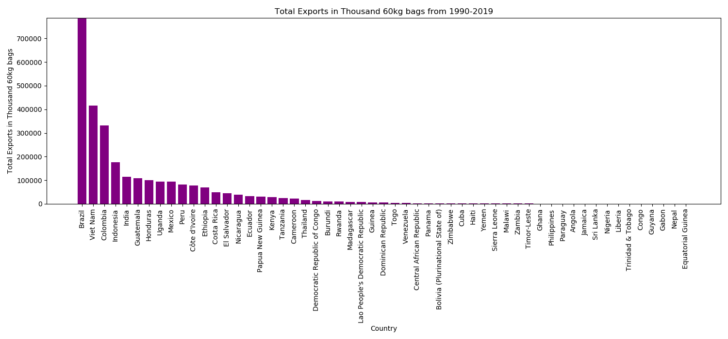
The number of countries producing (exporting) coffee and what volume?
Brazil
Vietnam
Colombia
Indonesia
Dominican Republic, Bolivia & Cuba
Top 4 price paid to growers
Jamaica Number 1 in price paid to growers
Notes:
The number of countries producing (exporting) coffee and what volume?
1990-2019
Exports (55 countries)
Imports (35 countries)
Countries, continents, volume in Thousand 60kg bags, Information derived from monthly reports.
(Keep in mind that 60kg is 132.277 pounds i.e. 1 kg = 2.20462 pounds)=
Dominican Republic, Bolivia and Cuba, considering this volume their price to growers is similar to other large volume exporters
Brazil in 2019 exported 35637.358589 Thousand 60kg bags = 132.277pounds, in 2019 average annual price to growers in Us cents/pound was 90.7803
35637.358589 x 1000 x 132.277pounds = (4714002882.077153 x 90.7803) ~ 100 = 4 279 385 958.36 Us dollars

Slide 9
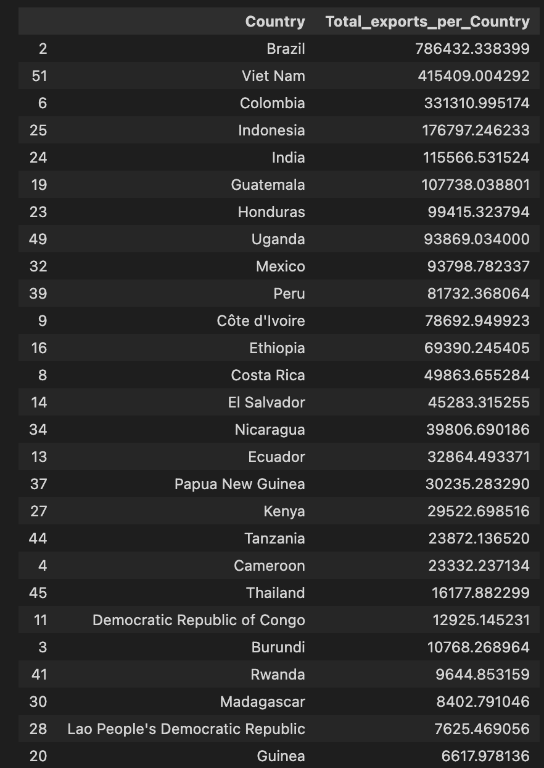
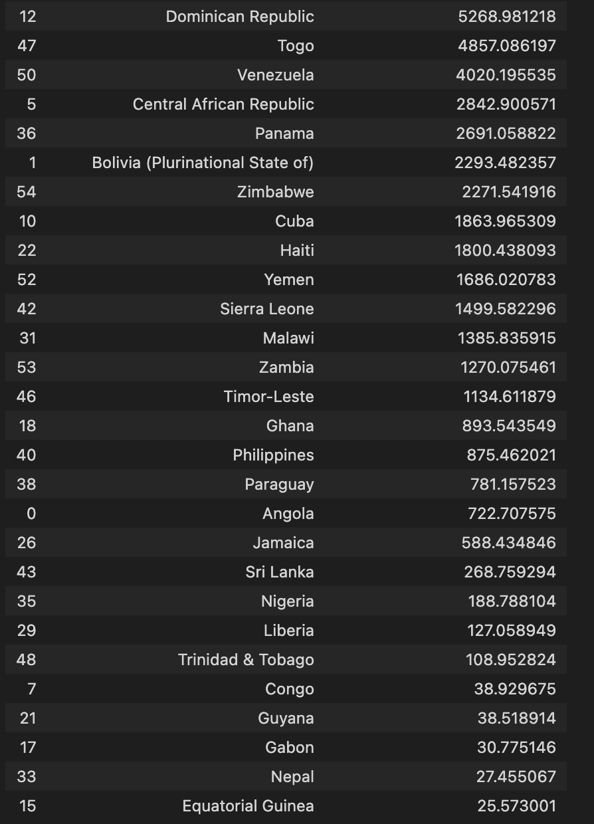

Slide 10

Import visualisation
Notes:
Photo by Nathan Dumlao on Unsplash
Top 5 importers (our data)
USA, Germany, Italy, Japan, France
According to Worldbank.org in 2019
https://wits.worldbank.org/trade/comtrade/en/country/ALL/year/2019/tradeflow/Imports/partner/WLD/product/090111
European Union 6,981,706.86 US (1000USD)
USA 4,383,151.39 US
Germany 2,414,505.16 US
Italy 1,358,782.96 US
Japan 1,139,560.46 US
Canada
Switzerland
France 558,163.00
Average exchange rate 2019 1.436 AUD
Our data
Upward import trends
Belgium (keep in mind up to 1998 combined Belgium-Luxembourg, then separate)
Bulgaria, Cyprus, Czechia, Finland, France, Germany, Greece, Ireland, Italy, Latvia, Lithuania, Luxembourg, Netherlands,
Poland, Portugal, Romania, Slovakia, Slovenia, Spain, Sweden, Japan, Russian federation, Switzerland, Tunisia, UK, USA
30 European countries, Japan, USA, Tunisia Russia
http://127.0.0.1:5000

Slide 11
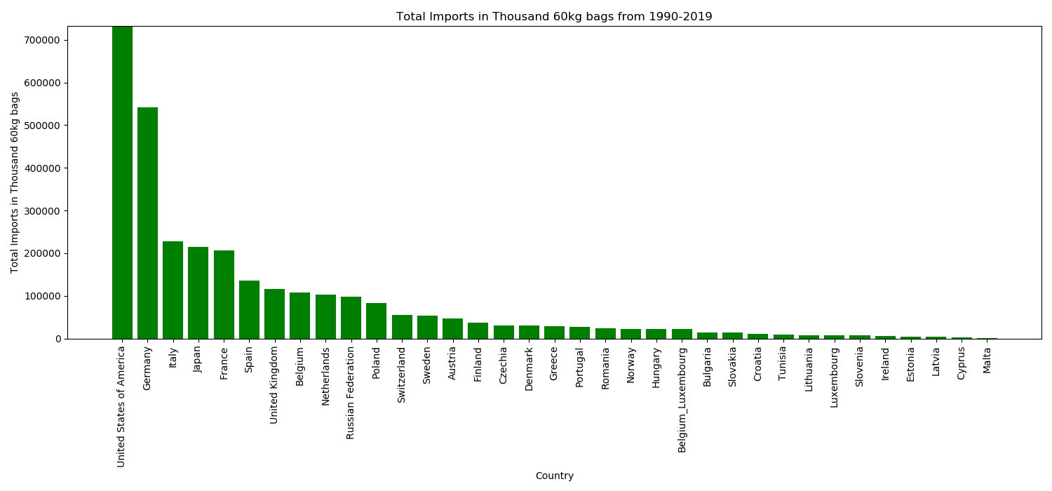

The number of countries buying (importing) coffee and what volume?
United State of America
Germany
Non _European countries
Notes:
The number of countries buying (importing) coffee and what volume?
1990-2019
Imports (35 countries)
Countries, continents, volume in Thousand 60kg bags, Information derived from monthly reports.
(Keep in mind that 60kg is 132.277 pounds i.e. 1 kg = 2.20462 pounds)

Slide 12
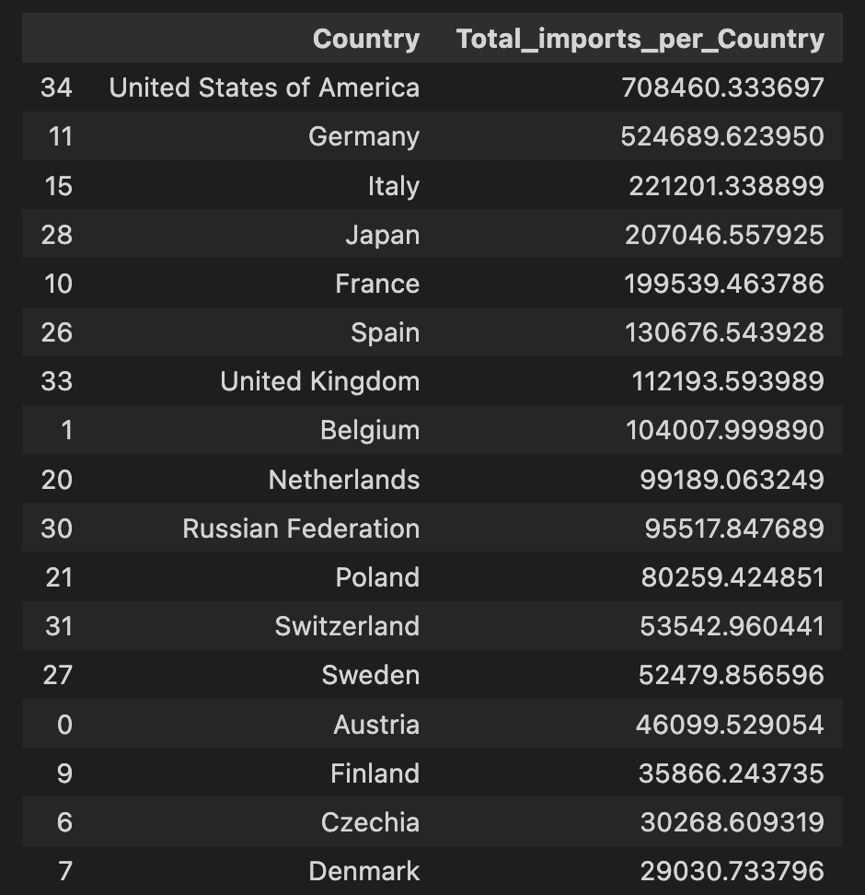
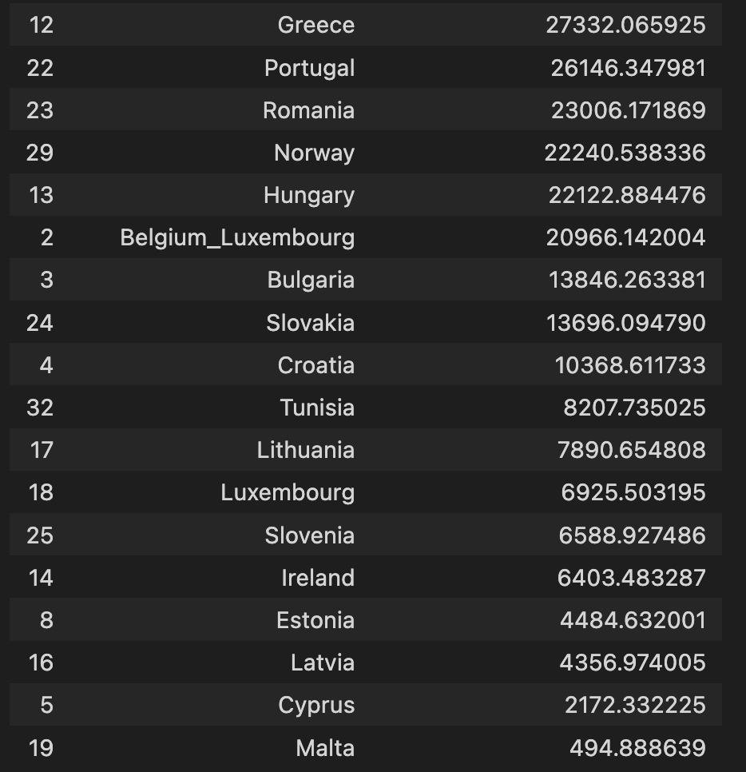

Slide 13
Price paid to growers visualisation.
Notes:
Photo by Christina Rumpf on Unsplash

Slide 14
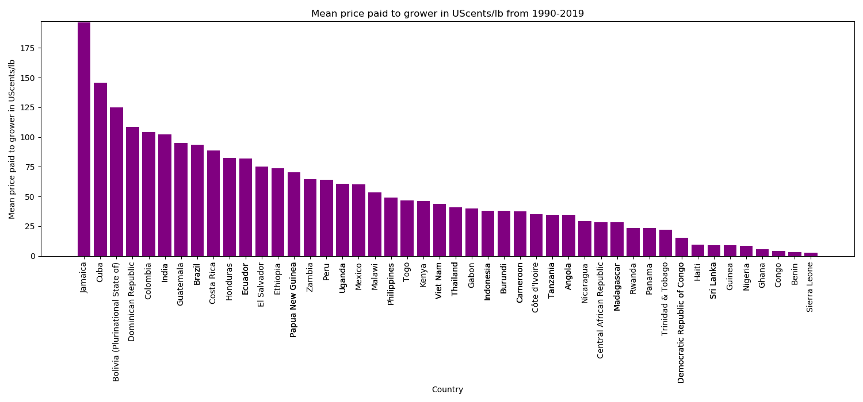

Price paid to growers.
4 main exporters
Indonesia
Notes:
Price paid to growers (62 countries)
US cents/lb as an annual average. (Keep in mind that 60kg is 132.277 pounds i.e. 1 kg = 2.20462 pounds)
Avg price paid to to grower at farmgate
OR min price guaranteed by the gov to the grower by form and weight reported in the national currency in which the coffee is purchased, converted to US cents/lb.
Coffee-type
Colombian Mild(27/62 countries)
Other milds(27/62 countries)
Brazilian Naturals(27/62 countries)
Robustas(27/62 countries)
Vietnam could leverage with buyers to pay more considering export volume and price paid to 2 other countries that had high export volumes
Spikes 1997 2011
Dips >1998 and after 2011
Burundi 2010, no trade data? did trade stop for those countries?
Other countries missing years of data
Upward price trends Bolivia, Togo, Dominican republic,

Slide 15
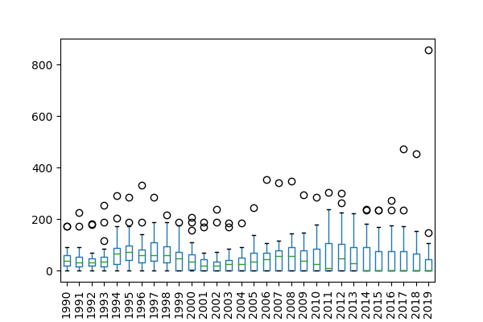
Price paid to growers.

Slide 16

Retail price visualisation.
Notes:
Photo by Nathan Dumlao on Unsplash

Slide 17
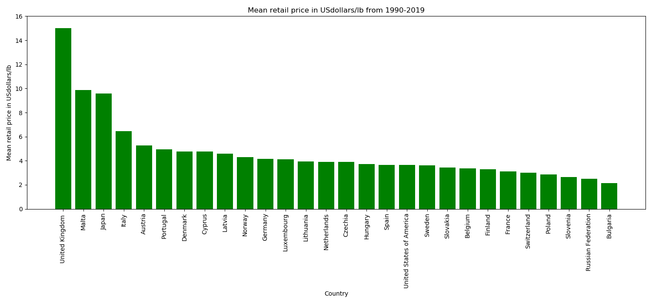
Retail price.
Non _European countries
Notes:
Retail price (28 countries)
(Global price of coffee)
US $/lb as an annual average.
Price paid by consumer to commercial distributor outlet.

Slide 18
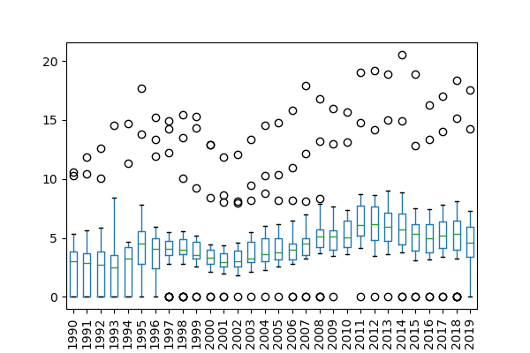
Retail price

Slide 19
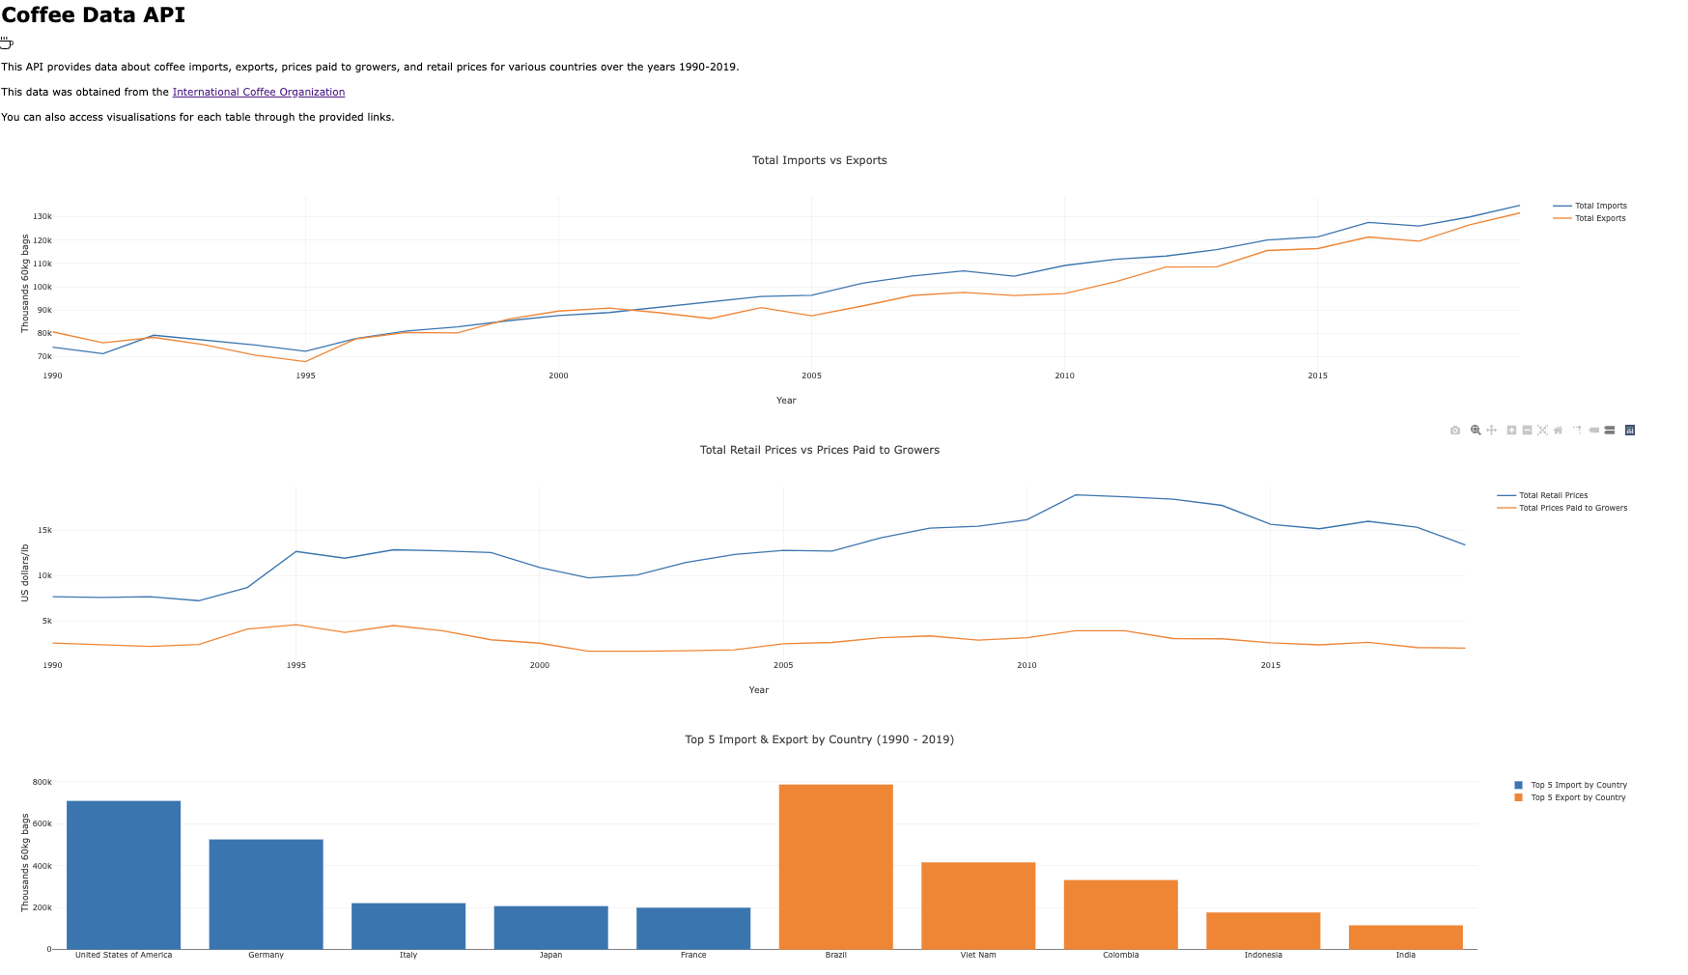
Comparison

Slide 20

Questions we still have about the Global Coffee Trade.
Notes:
Questions we still have about the Global Coffee Trade.
Type of coffee and global trends
Robustas
Arabica (Brazilian Naturals, Other Milds, Colombian Milds)
Regional exports
Africa
Asia & Oceania
Central America & Mexico
South America
Impact of adverse weather, global fertilizer costs.
How is the retail price determined?

Slide 21

Conclusion & Questions
Notes:
Limited by the scope of the data
the number of countries.
the values e.g. pounds instead of kg, Us cents and dollars instead of the same or AUD
Information regarding what price guarantee by gov’s to growers based on their national currency
Understanding the ICO’s aggregation of values for analytical purposes as it does not represent production on the ground with individual countries.
Conclusion is that global demand for coffee (coffee consumption) is being impacted by:
current decelerating global economic growth
rising cost of living
Especially considering non-producing countries such as Europe.
Data for 2019 to present may have portrayed a very different picture.
Does anyone have any questions?
What did you like or enjoy about this story?
What will you remember?

